Slide 1

VISUAL PROGRAMMING CSC444/CSC412 WPF-Data Binding

Slide 2
Topics to Cover
WPF - Data Binding
Types of Data Binding
Sample code to understand Data Binding

Slide 3
What is Data binding
Data binding is a mechanism in WPF applications that provides a simple and easy way to display and interact with data.
Data binding allows the flow of data between UI elements and data object on user interface.
We can use any object as the data source such as database, XML, Collection etc and bind to the WPF UI Element such as Listbox, Textblock etc which are called as Targets
When a binding is established and the data (business model) changes, then it reflects the updates automatically to the UI elements and vice versa.

Slide 4
Types of Data binding
There are four modes of Data binding in WPF −
OneWay data binding
TwoWay data binding
OneWayToSource
OneTime

Slide 5
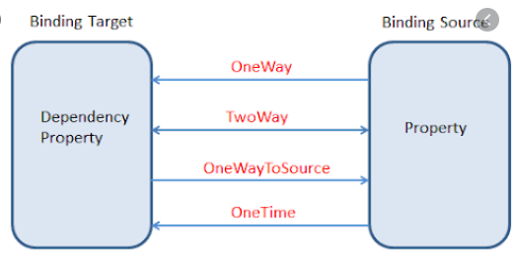
Data Bindings in WPF

Slide 6
One-Way Data Binding
In one-way binding, data is bound from its
source (that is the object that holds the data) to its
target (that is the object that displays the data)
<TextBox Name = "ageText"
Text = "{Binding Age, Mode = OneWay}"/>

Slide 7
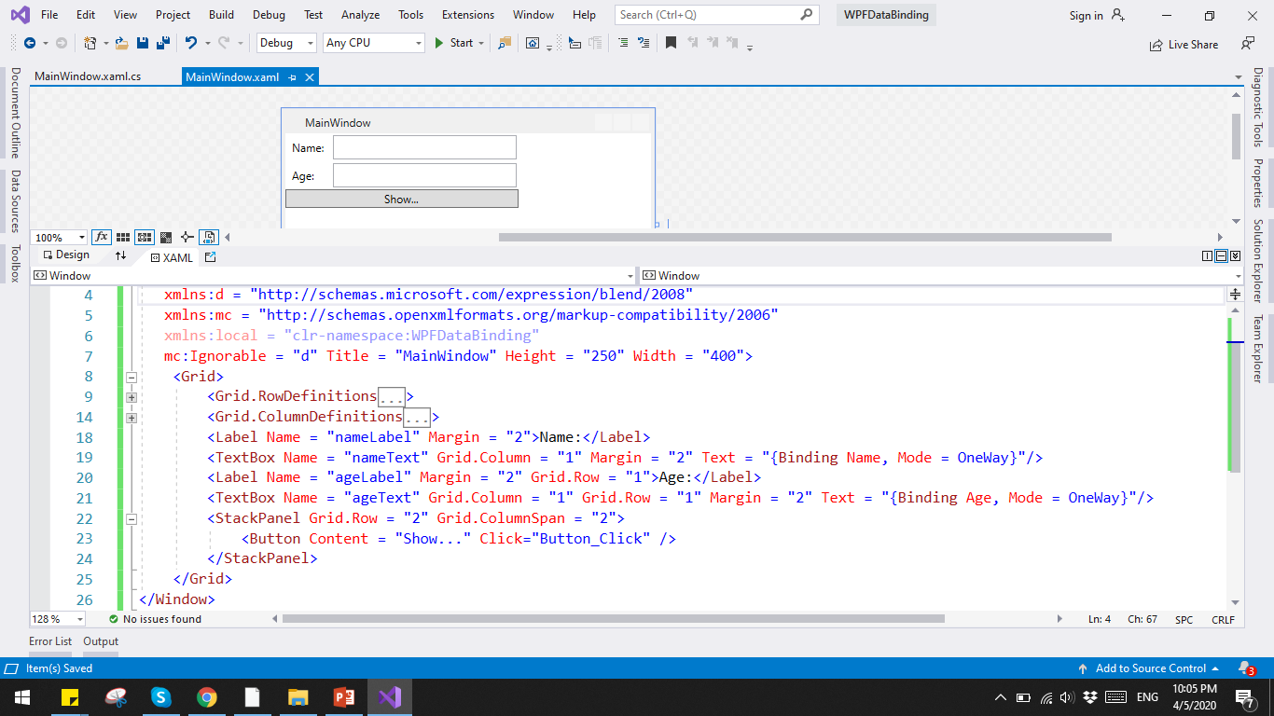
One-Way Data Binding

Slide 8
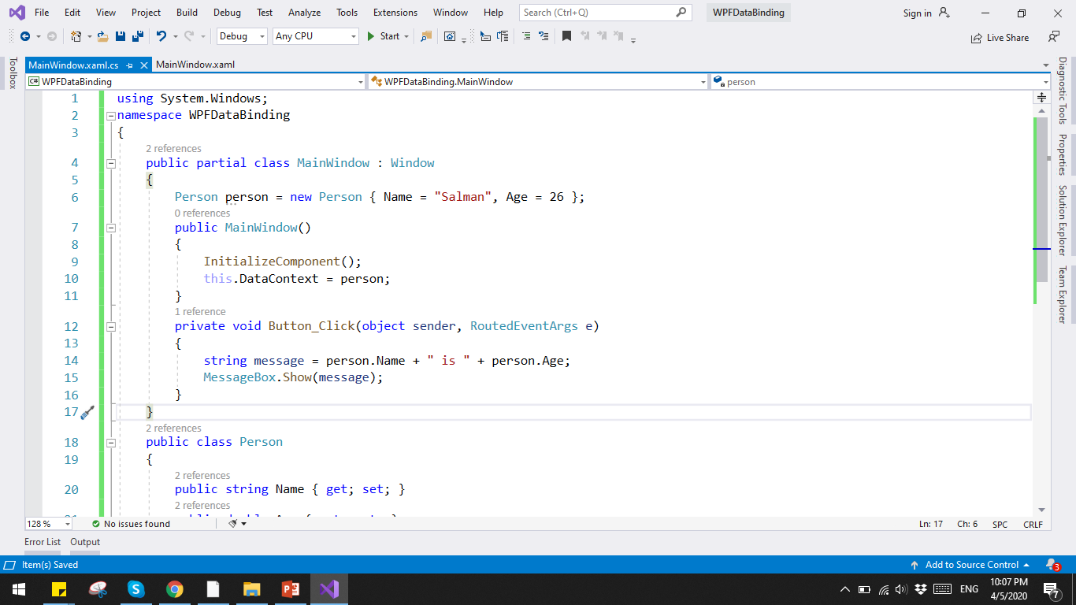
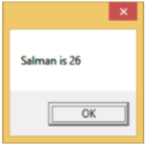
One-Way Data Binding

Slide 9
Two-Way Data Binding
In two-way binding, the user can modify the data through the user interface and have that data updated in the source.
If the source changes while the user is looking at the view, you want the view to be updated.
<TextBox Name = "nameText"
Text = "{Binding Name, Mode = TwoWay}"/>

Slide 10
Data Context
WPF uses a dependency property called as Data Context property to net the source of bindings.
If any other source is not specified for data bindings then WPF by default searches the Data Context.
There's no default source for the Data Context property, you need to assign it some value otherwise binding will be null.
So when ever you are using binding you are binding with data context of the corresponding element.

Slide 11
Element data binding
It is also possible to bind, not to a standard data source, but to another element on the page.

Slide 12
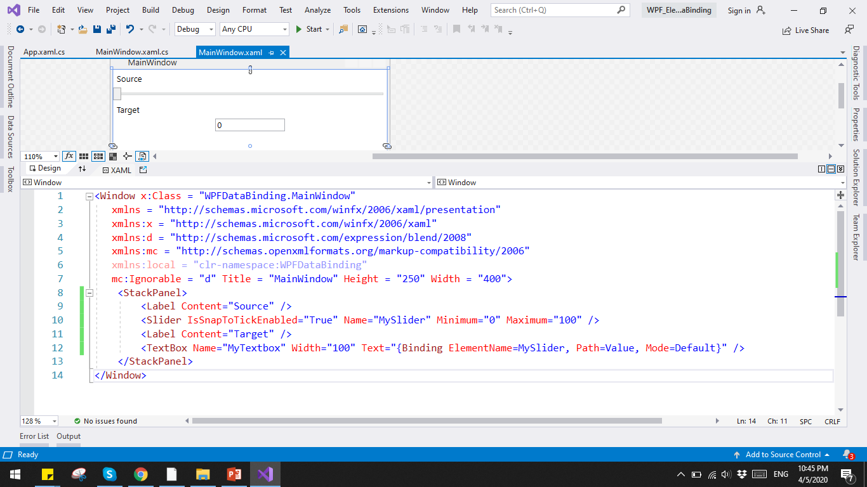
Element data binding

Slide 13
Thankyou
Any question ?

